Slide 1
ieilms.jbnu.ac.kr

Slide 2
Chapter 21
Electric Charge and Electric Field

Slide 3
Learning Goals for Lecture 2
Looking forward at …
the distinction between electric force and electric field.
how to use the idea of electric field lines to visualize and interpret electric fields.

Slide 4
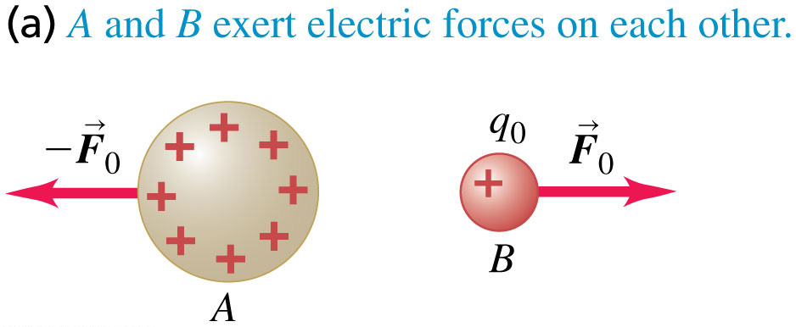
Electric field: Introduction Slide 1 of 3
To introduce the concept of electric field, first consider the mutual repulsion of two positively charged bodies A and B.
Body A, as a result of the charge that it carries, somehow modifies the properties of the space around it. Then body B, as a result of the charge that it carries, senses how space has been modified at its position. The response of body B is to experience the force F_{o}
0.

Slide 5
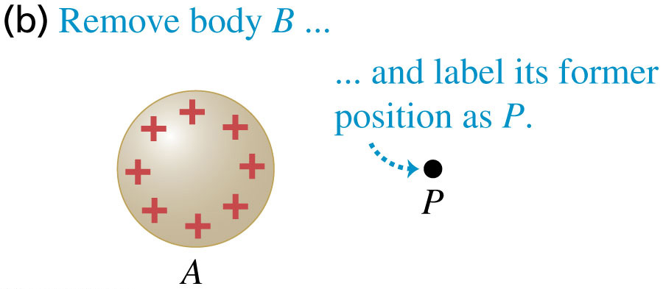
Electric field: Introduction Slide 2 of 3
Next consider body A on its own.
We can say that body A somehow modifies the properties of the space at point P.
The charged body A produces or causes an electric field at point P (and at all other points in the neighborhood).

Slide 6
To find out experimentally whether there is an electric field at a particular point, we place a small charged body, which we call a test charge, at the point.

Slide 7
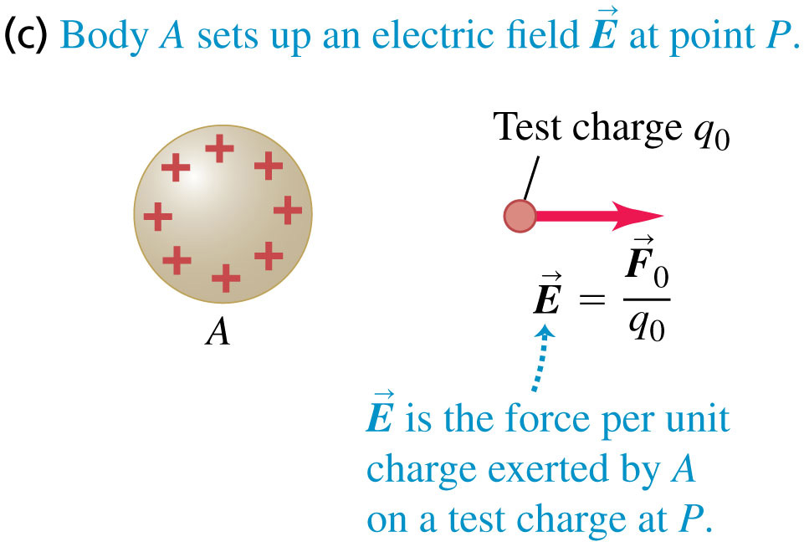
Electric field: Introduction Slide 3 of 3
We can measure the electric field produced by A with a test charge.
We take
the point of view that this force is exerted on q₀ by the field at P

Slide 8
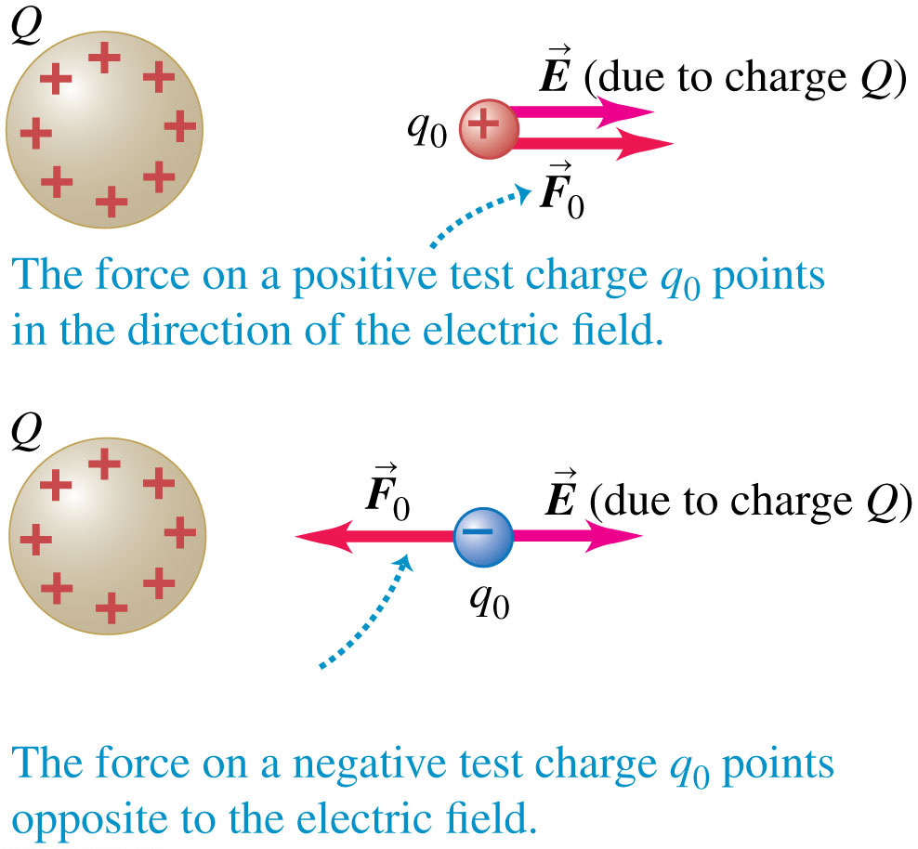
Electric force produced by an electric field

Slide 9
A single charge produces an electric field in the surrounding space, but this electric field cannot exert a net force on the charge that created it.

Slide 10
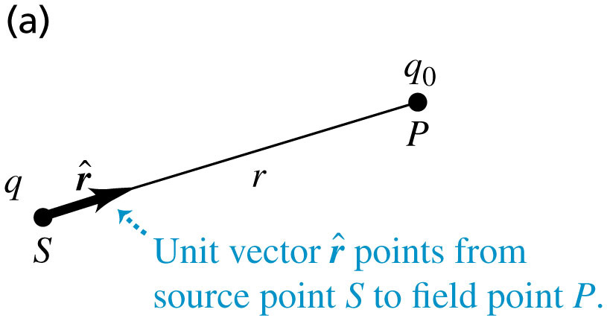
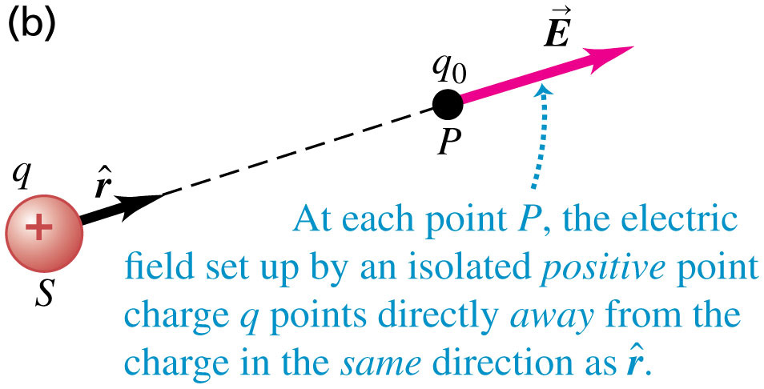
The electric field of a point charge

Slide 11
If we place a small test charge q₀ at the field point P, at a distance r from the source point, the magnitude F₀ of the force is given by Coulomb’s law
the magnitude E of the electric field at P is

Slide 12
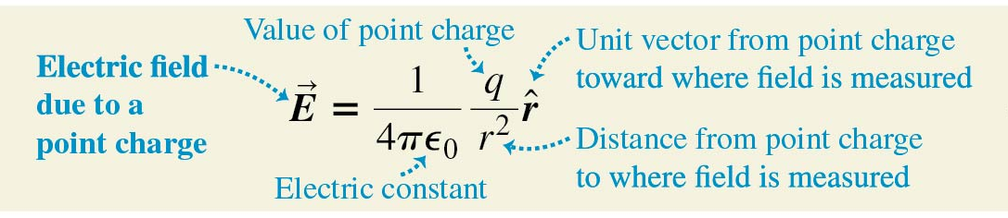
The electric field of a point charge
Using a unit vector that points away from the origin, we can write a vector equation that gives both the magnitude and the direction of the electric field:

Slide 13
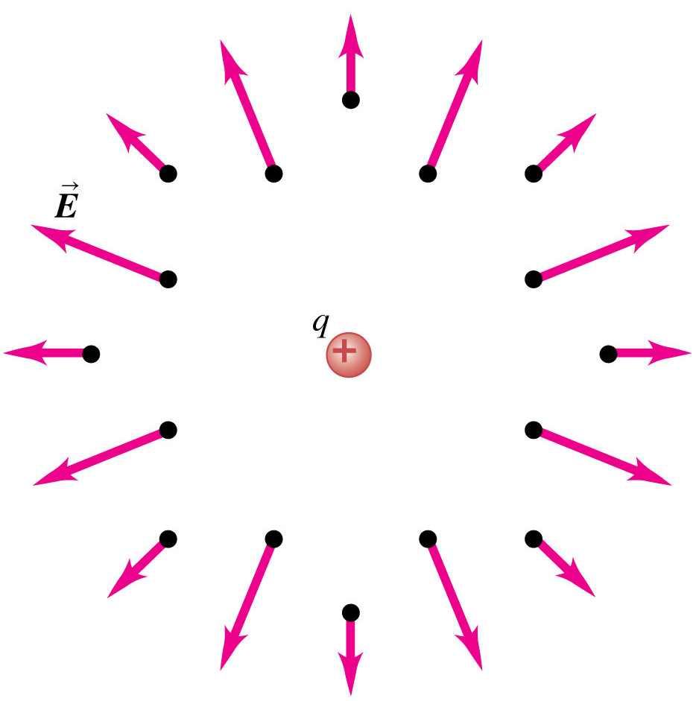
Electric field of a point charge
A point charge q produces an electric field at all points in space.
The field strength decreases with increasing distance.
The field produced by a positive point charge points away from the charge.

Slide 14
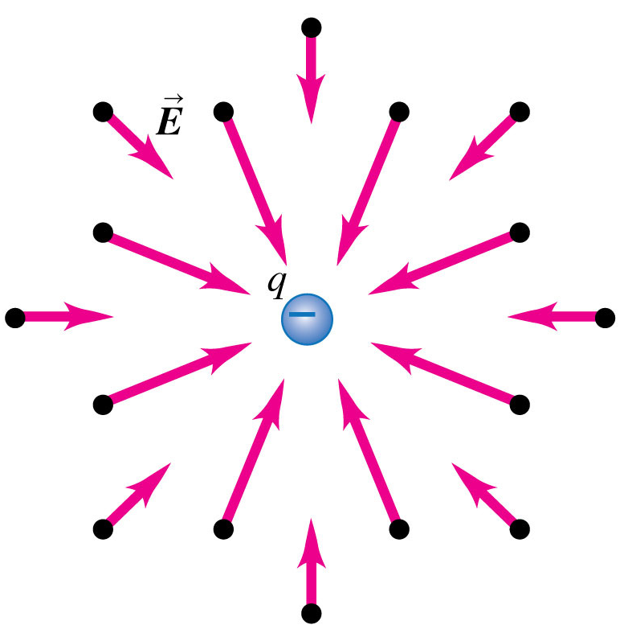
Electric field of a point charge
A point charge q produces an electric field at all points in space.
The field strength decreases with increasing distance.
The field produced by a positive point charge points toward the charge.

Slide 18
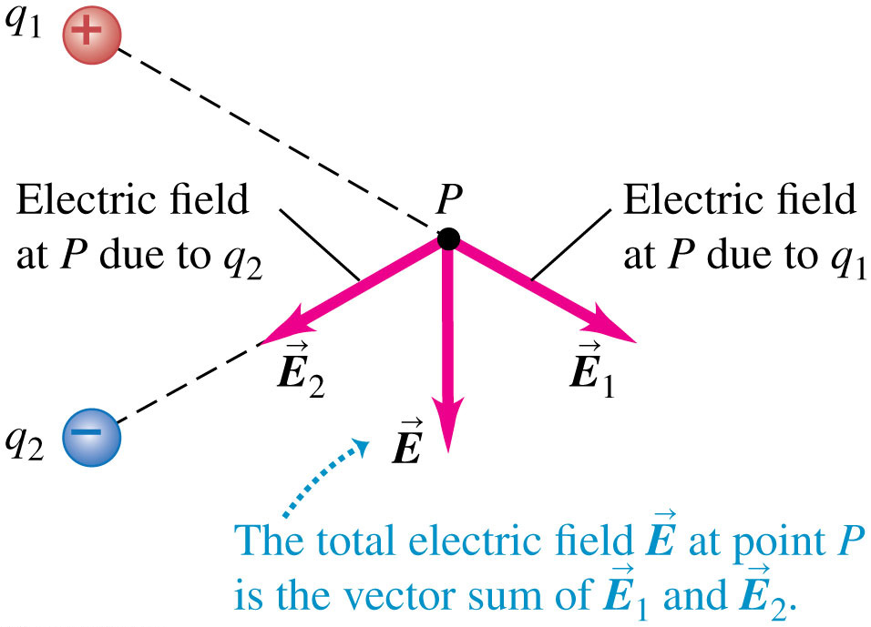
Superposition of electric fields
The total electric field at a point is the vector sum of the fields due to all the charges present.

Slide 28
At x = 0
That is, when the ring is so far away that its radius is negligible in comparison to the distance x, its field is the same as that of a point charge.
At x >> 0

Slide 30
At x >> a
Then the field becomes that of a point charge
At a >> x

Slide 31
2πr
dr
dA = 2πr dr
The charge per unit area is
σ = dQ/dA, dQ = σ dA = σ2πr dr

Slide 32
Let t = x² + r² , dt = 2rdr
Hence the electric field produced by an infinite plane sheet of charge is independent of the distance from the sheet. The field direction is everywhere perpendicular to the sheet, away from it.

Slide 34
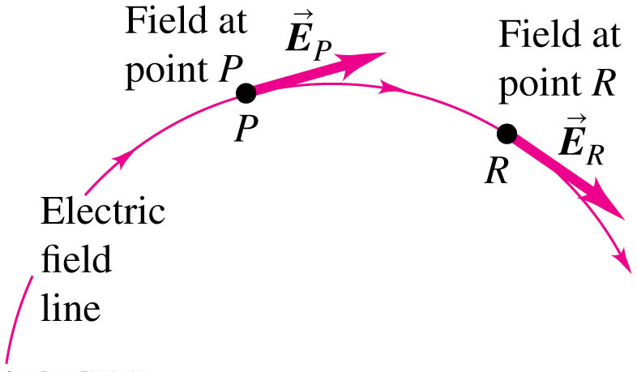
Electric field lines
An electric field line is an imaginary line or curve whose tangent at any point is the direction of the electric field vector at that point.

Slide 35
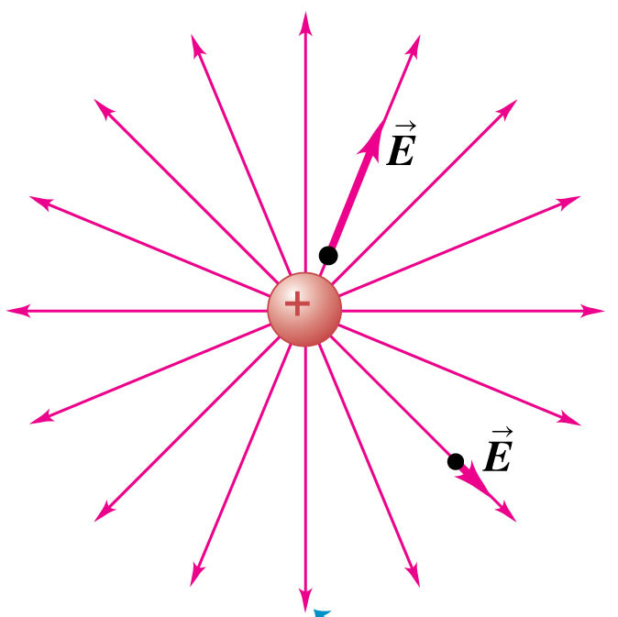
Electric field lines of a point charge
Electric field lines show the direction of the electric field at each point.
The spacing of field lines gives a general idea of the magnitude of the electric field at each point.

Slide 36
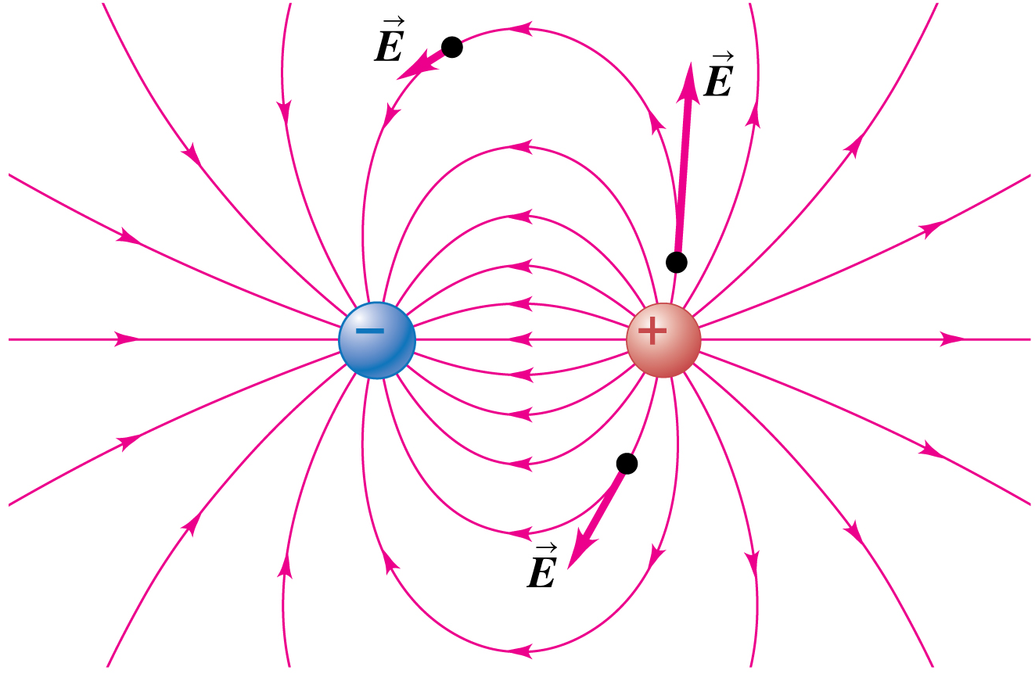
Electric field lines of a dipole
An electric dipole is a pair of point charges with equal magnitude and opposite sign (a positive charge q and a negative charge -q) separated by a distance d.
Field lines point away from + charges and toward – charges.

Slide 37
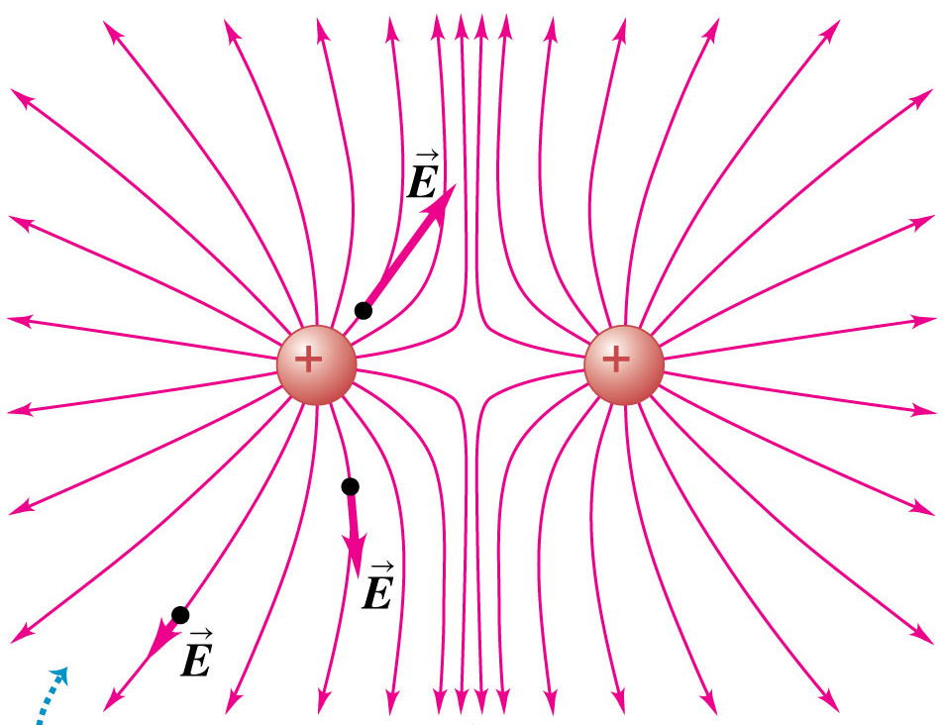
Electric field lines of two equal positive charges
At any point, the electric field has a unique direction, so field lines never intersect.

Slide 38
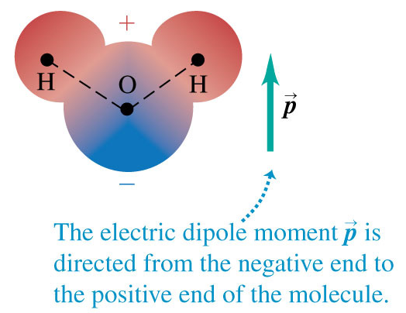
The water molecule is an electric dipole
The water molecule as a whole is electrically neutral, but the chemical bonds within the molecule cause a displacement of charge.
The result is a net negative charge on the oxygen end of the molecule and a net positive charge on the hydrogen end, forming an electric dipole.

Slide 39

The water molecule is an electric dipole
When dissolved in water, salt dissociates into a positive sodium ion and a negative chlorine ion, which tend to be attracted to the negative and positive ends of water molecules.
This holds the ions in solution.
If water molecules were not electric dipoles, water would be a poor solvent, and almost all of the chemistry that occurs in aqueous solutions would be impossible!

Slide 40
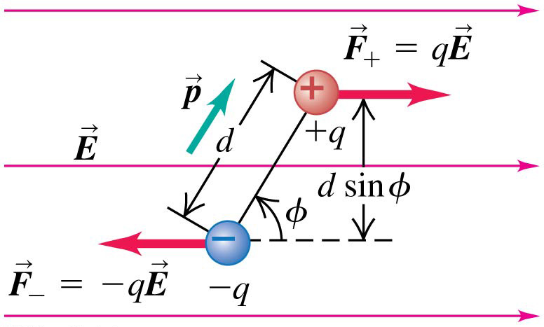
Force and torque on a dipole
When a dipole is placed in a uniform electric field, the net force is always zero, but there can be a net torque on the dipole.
The electric dipole moment, denoted by p:

Slide 43
SUMMARY

Slide 44
SUMMARY
Superposition of electric fields: The electric field E
of any combination of charges is the vector sum of the fields caused by the individual charges.

